Slide 1
Interactive Visualisation
RSS International Conference 2021
Joe Russell
tinyurl.com/rssvis

Slide 2
Agenda slide – orange block heights represents time spent on each section
Agenda
Why?
What is shiny?
Building apps
Where next?
Questions

Slide 3


Section title – Flat colour – Image sent to back
Why?

Slide 4
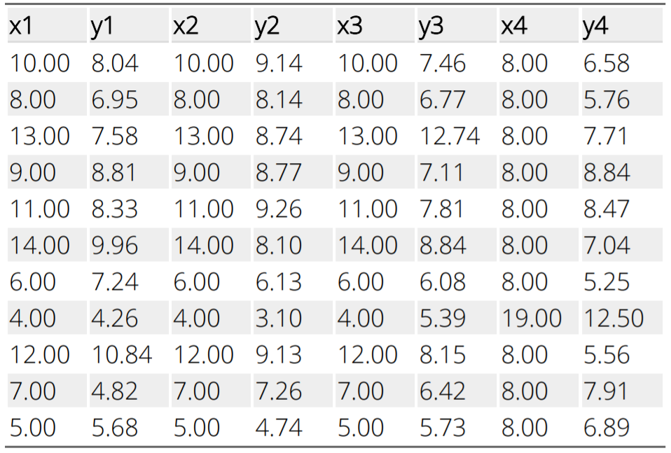
Why Visualisation?

Slide 5
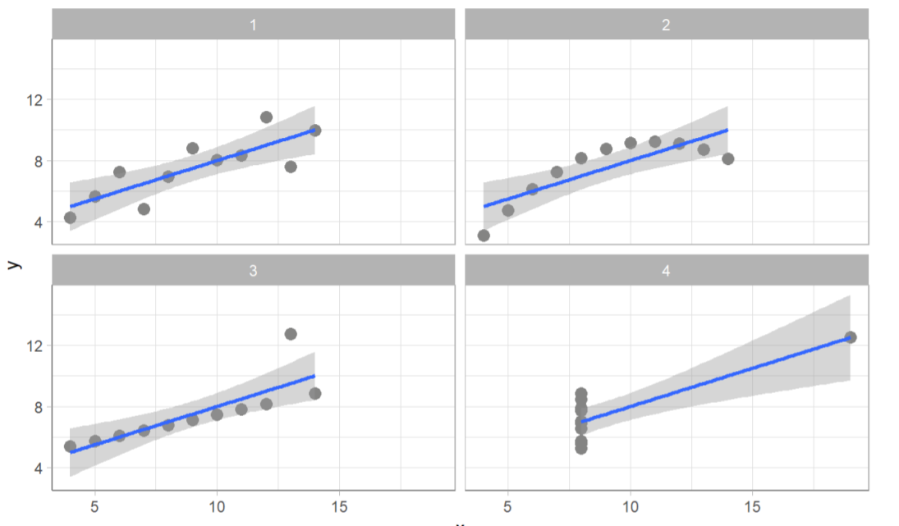
Why Visualisation?

Slide 6
Why Visualisation?
Explore data
Spot trends or patterns
Identify outliers
Communicate results

Slide 7
Why Interactive?
Dynamically explore data
Spot new trends or patterns
Identify new outliers
Communicate results while facilitating drill-down

Slide 8

Section title – Flat colour – Image sent to back
What is Shiny?

Slide 9

What is Shiny?
R Package
Allows creation of web applications
No HTML/CSS/JavaScript/... required
Can be written entirely in R

Slide 10
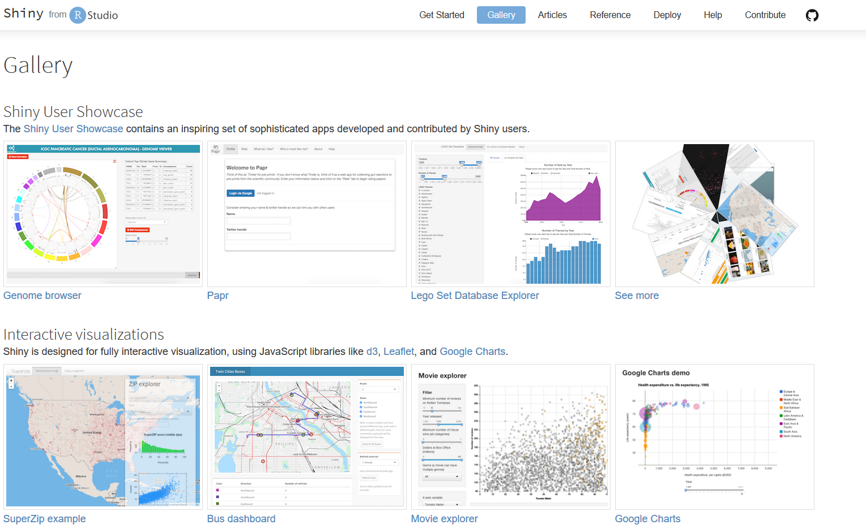
What’s Shiny For?
Allowing your app users to benefit from R’s amazing functionality without them needing to learn R

Slide 11
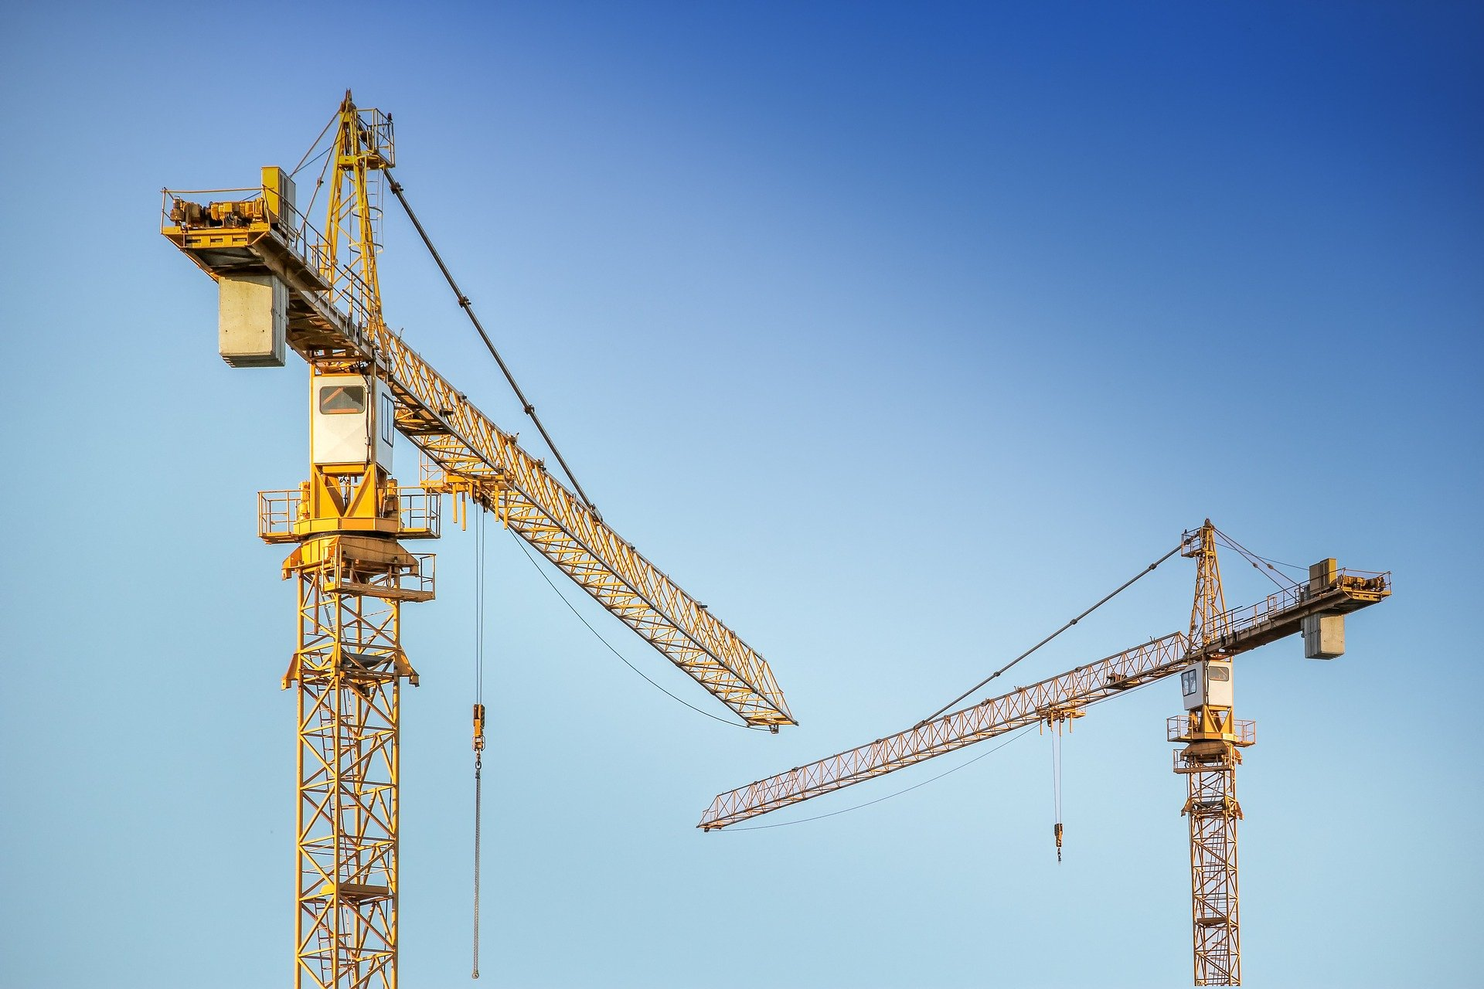
Section title – Flat colour – Image sent to back
Building Apps

Slide 12
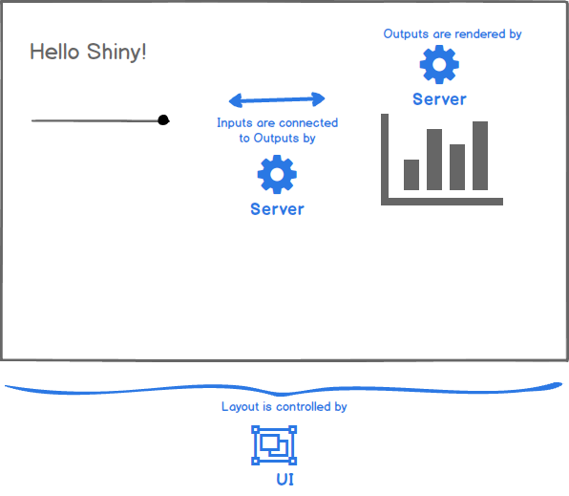
A Basic Shiny App
Requires two components:
A UI (User Interface) that defines how your app looks
A server that defines how your app works

Slide 13
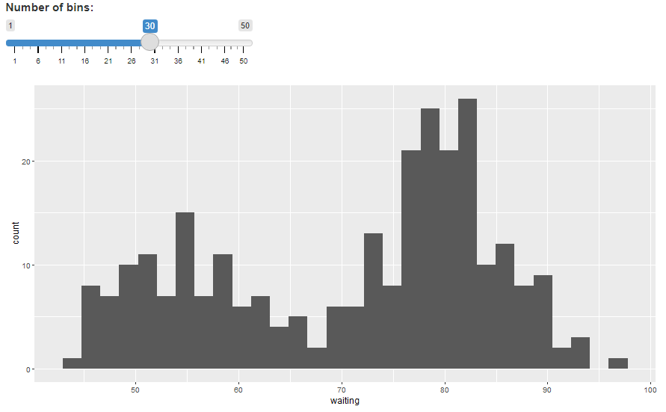
Demo App

Slide 14
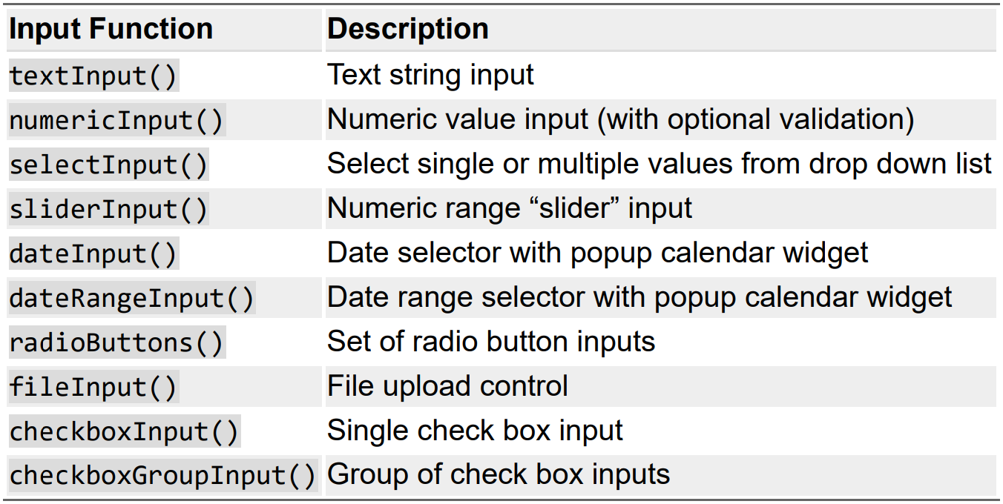
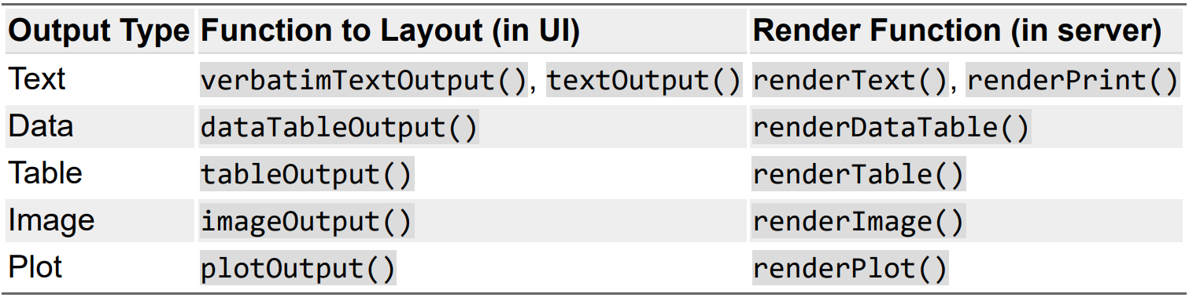
Inputs and Outputs

Slide 15

Section title – Flat colour – Image sent to back
Where Next?

Slide 16
Where Next?
https://shiny.rstudio.com/
https://mastering-shiny.org/index.html
https://www.shinyapps.io/

Slide 17

Section title – Flat colour – Image sent to back
Questions?

